Slide 1
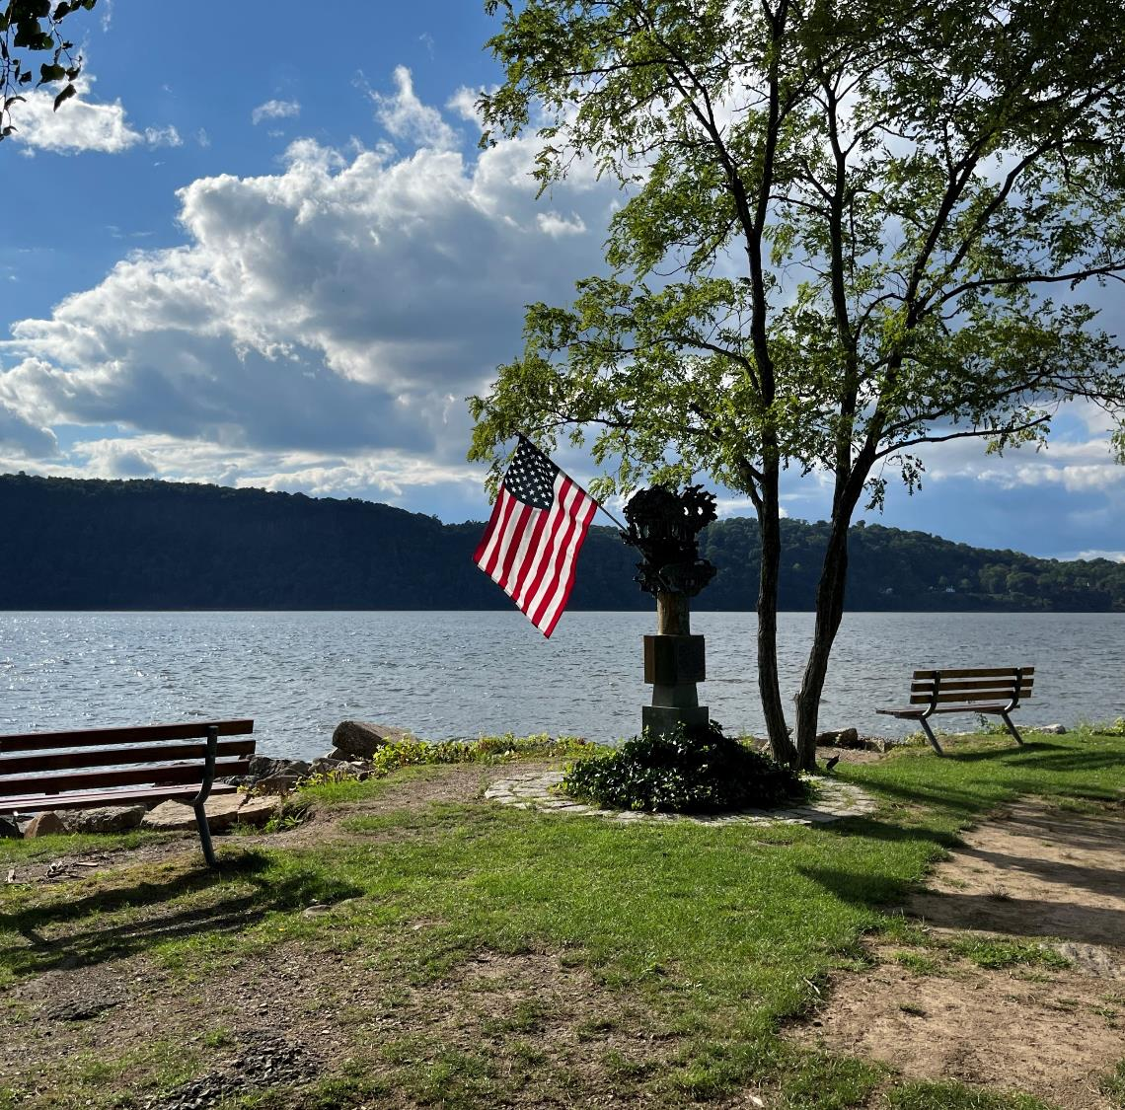
Village of
Hastings-on-Hudson
COMPREHENSIVE PLAN
UPDATE &
LOCAL WATERFRONT REVITALIZATION PROGRAM
Committee Meeting
May 22, 2024
James Harmon Community Center

Slide 2
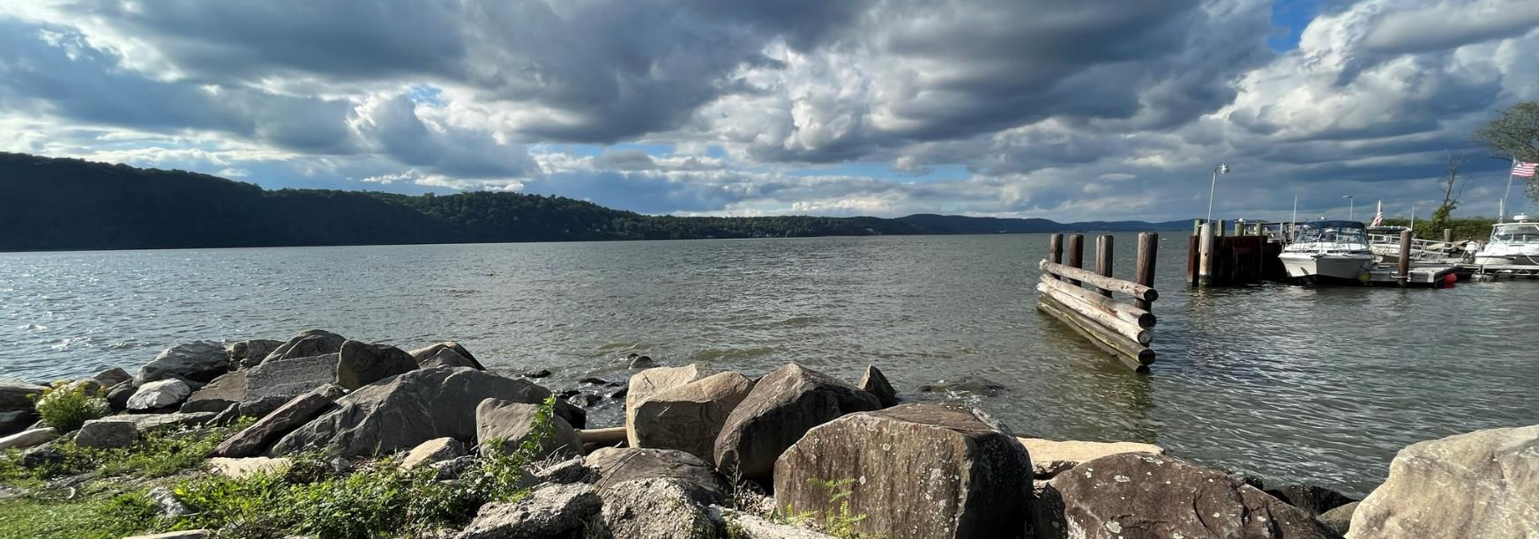
WELCOME

Slide 3
This presentation was prepared with funding provided by the New York State Department of State under Title 11 of the Environmental Protection Fund.

Slide 4
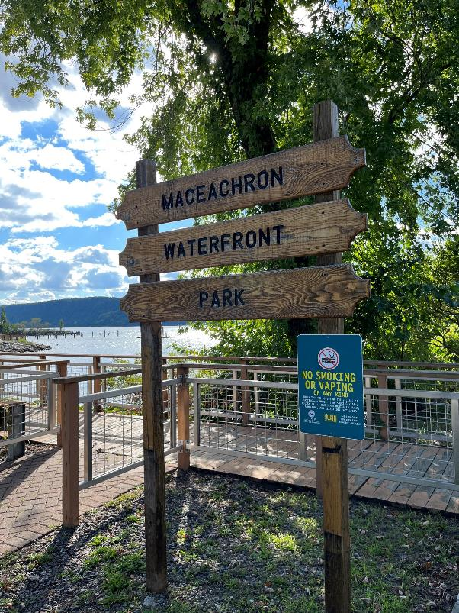
AGENDA
Approval of Meeting Summary
Project Status Update
Committee Comprehensive Plan Comments Presentation/Discussion
Committee Consideration of Setting Public Hearing
Committee Tasks and Next Steps
Public Comment

Slide 5
APPROVAL OF MEETING SUMMARIES
April 10, 2024

Slide 6
PROJECT STATUS UPDATE
*CPU Kick-off
Initiate Data Collection & Analysis
Public Participation Plan
Project Website
Draft Plan Recs
Draft LWRP
3rd Round Public Engagement
Draft Comp Plan
Draft LWRP
1st Round Public Engagement
Data Collection & Analysis
LWRP Policies
Comp Plan Vision & Goals
Comp Plan Strategies & Recommendations
LWRP Proposed Project & Uses
2nd Round Public Engagement
Committee Public Hearing
Revised Draft Comp Plan
Preliminary Draft LWRP
Final Comprehensive Plan (Trustees)
Adoption of Plan (Trustees)
Summer/Fall 2023 / Winter 2024
Spring/ Summer 2024
Fall 2022
Winter 2022-23
Spring 2023
Summer/Fall 2024

Slide 7
PROJECT STATUS UPDATE
At the Committee Public Hearing, the public will have the opportunity to provide comment on the Draft Comprehensive Plan.
Following the Committee Public Hearing, the Committee will consider public comment received and any additional edits to be incorporated into the plan.
Remaining Key Committee Steps (Anticipated)
May 2024
3rd/Potential Final Committee Draft Comprehensive Plan
Consider scheduling Committee Public Hearing
July 2024 (?)
Discuss edits to Final Committee Draft Comprehensive Plan
Consider vote to forward Draft Comprehensive Plan to Board of Trustees
Following preparation of Final Committee Draft Comprehensive Plan, the Committee will vote forward the Final Draft Comprehensive Plan to the Village Board of Trustees to consider initiating the adoption process which is anticipated to include several steps such as:
Village Board of Trustees Public Hearing
Compliance with SEQRA
GML 239-M County Planning Board Referral
Plan Revisions as appropriate

Slide 8
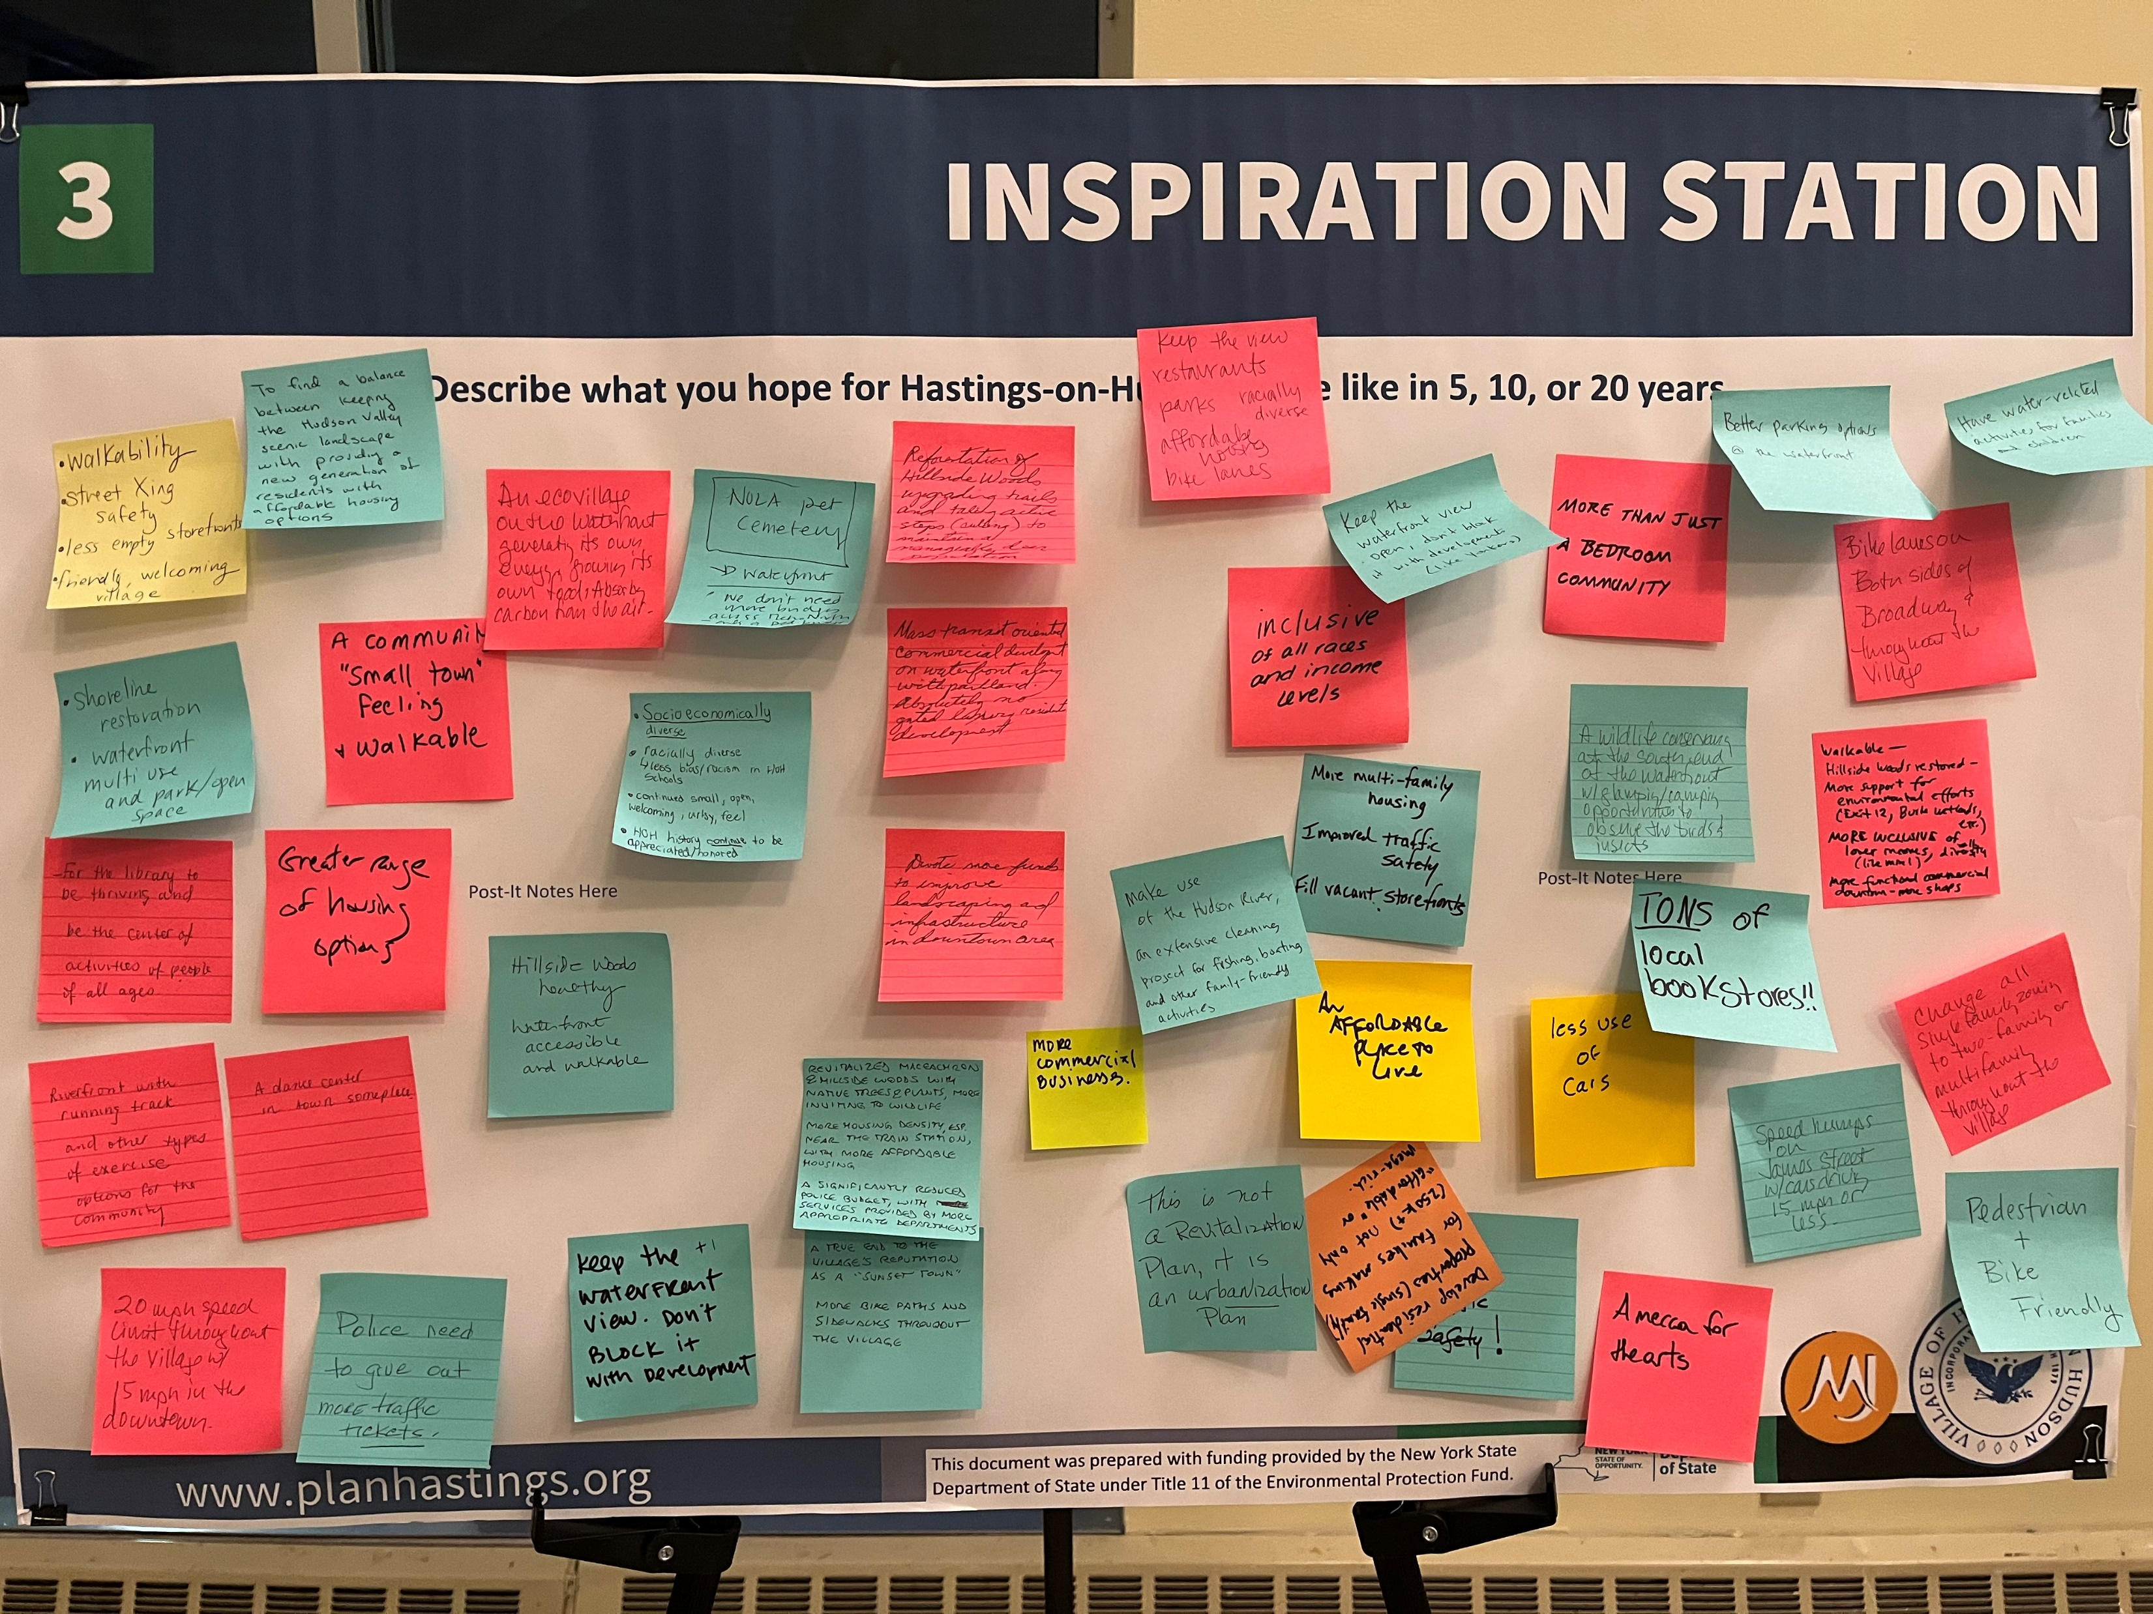
PROJECT STATUS UPDATE
Remaining Committee Public Engagement (Anticipated)
Public Engagement #4/Committee Public Hearing - TBD
Summer 2024
Draft Comprehensive Plan for public viewing in advance
Committee Public Hearing on Draft Comprehensive Plan
NOTE: The Village Board of Trustees is required to hold a public hearing on the draft plan prior to adoption.

Slide 9
COMMITTEE COMPREHENSIVE PLAN COMMENTS PRESENTATION

Slide 10
COMMITTEE COMPREHENSIVE PLAN COMMENTS PRESENTATION
Discussion Timeframes
Introduction: | 5 Minutes
Vision, Goals and Smart Growth Principles: | 5 Minutes
Village Overview: | 5 Minutes
History and Placemaking: | 5 Minutes
Housing: | 5 Minutes
Economic Vitality: | 5 Minutes
Sustainability and Resiliency: | 5 Minutes
Recreation: | 5 Minutes
Connectivity, Mobility and Access: | 5 Minutes
Waterfront: | 5 Minutes
Governance: | 5 Minutes
Implementation: | 5 Minutes
Do the revised sections reflect your comments and/or the intent of your comments?
Do you support sharing the draft Comprehensive Plan for public review and scheduling the Committee public hearing (with your minor edits on Version 3 or as discussed today)?
Reminder: Following the Committee Public Hearing, an additional Committee meeting is anticipated to consider public comment received and any additional edits to be incorporated into the plan.

Slide 11
DRAFT INTRODUCTION (5 Minutes)_
General Version 3 Comments Received:
Minor Formatting & Text Edits
Photo Updates
Reviewers:
Dave Gunton
Trustee Drake
Mary Beth Murphy

Slide 12
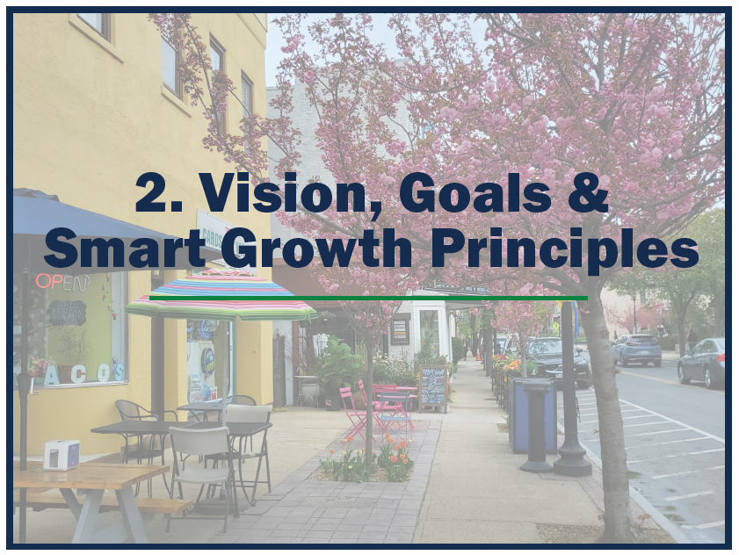
DRAFT VISION, GOALS AND SMART GROWTH PRINCIPLES (5 Minutes)
General Version 3 Comments Received:
No edits
Reviewers:
Chris Thomas
Edward Kuch

Slide 13
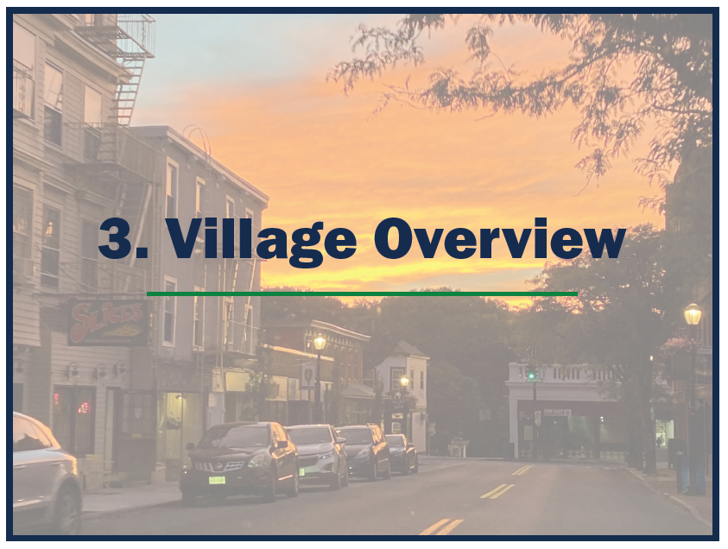
DRAFT VILLAGE OVERVIEW (5 Minutes)
General Version 3 Comments Received:
Minor Text edits/clarification
Inclusion of Previous Accomplishments (?)
Reviewers:
Trustee Drake
Meghann Donahue
Mary Beth Murphy

Slide 14
DRAFT HISTORY AND PLACEMAKING (5 Minutes)
General Version 3 Comments Received:
Formatting & Text Edits
Minor content additions
Minor content edits/clarification
Minor Recommendation edits
Reviewers:
Sarah Dupere Ostro
Meg Walker
Natalie Barry
Mary Beth Murphy

Slide 15
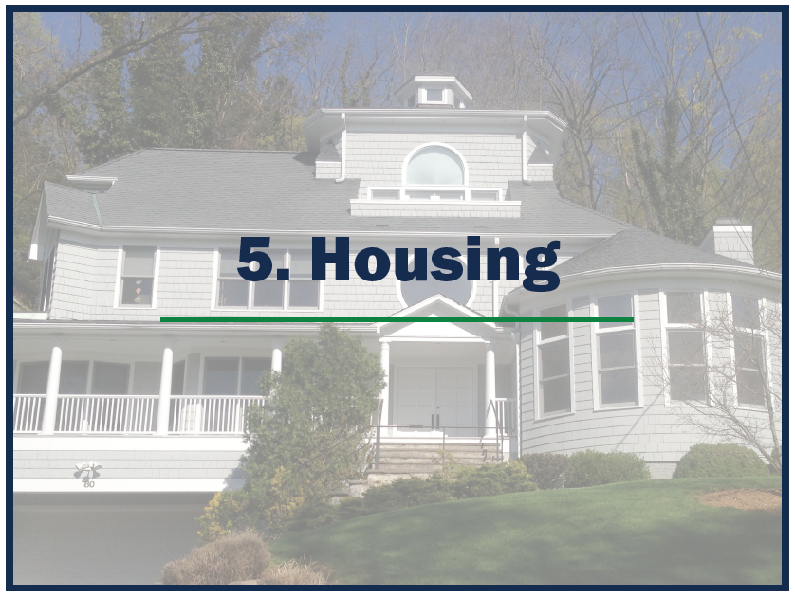
DRAFT HOUSING (5 Minutes)
General Version 3 Comments Received:
Include data reference
Minor text edits
Minor content clarifications
Formatting
Recommendation edits and modifications to descriptions
Reviewers:
Chris Thomas
Dave Gunton
Mary Beth Murphy

Slide 16
DRAFT ECONOMIC VITALITY (5 Minutes)
General Version 3 Comments Received:
Minor text edits
Minor content clarifications
Minor Recommendation edits
Reviewers:
Richard Bass
Meghann Donahue
Mary Beth Murphy

Slide 17
DRAFT SUSTAINABILITY AND RESILIENCY (5 Minutes)
General Version 3 Comments Received:
Minor Recommendation Edits
Reviewers:
J. Patrick Diggins
Sarah Dupere Ostro

Slide 18
DRAFT RECREATION (5 Minutes)
General Version 3 Comments Received:
Minor content addition
Text edits
Reviewers:
Samantha Merton
Edward Kuch

Slide 19
DRAFT CONNECTIVITY, MOBILITY AND ACCESS (5 Minutes)
General Version 3 Comments Received:
Minor recommendation edits
Reviewers:
Samantha Merton
Natalie Barry

Slide 20
DRAFT WATERFRONT (5 Minutes)
General Version 3 Comments Received:
Formatting & Text Edits
Minor content edits
Parcel graphic update
Reviewers:
Meg Walker
J. Patrick Diggins
Trustee Fleisig

Slide 21
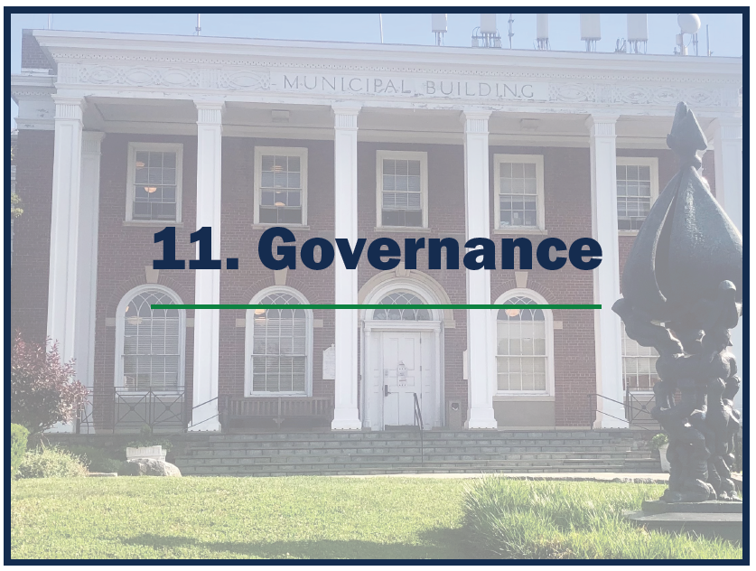
DRAFT GOVERNANCE (5 Minutes)
General Version 3 Comments Received:
Minor text edits
Minor content addition
Reviewers:
Mary Beth Murphy
Richard Bass
Trustee Fleisig

Slide 22
DRAFT IMPLEMENTATION (5 Minutes)
General Version 3 Comments Received:
Formatting & Text Edits
Minor content edits
Inclusion of Comprehensive Plan Oversight Committee Recommendation (?)
Reviewers:
Mary Beth Murphy
Trustee Fleisig

Slide 23
Discussion of Public Meeting #4 / Committee Public Hearing
Public Meeting #4 - Committee Public Hearing
This hearing will be scheduled once the Committee decides the draft Comprehensive Plan is ready for public review
Formally noticed by Village
Brief introductory presentation by MJ
Public comment period
Summary of public comments

Slide 24
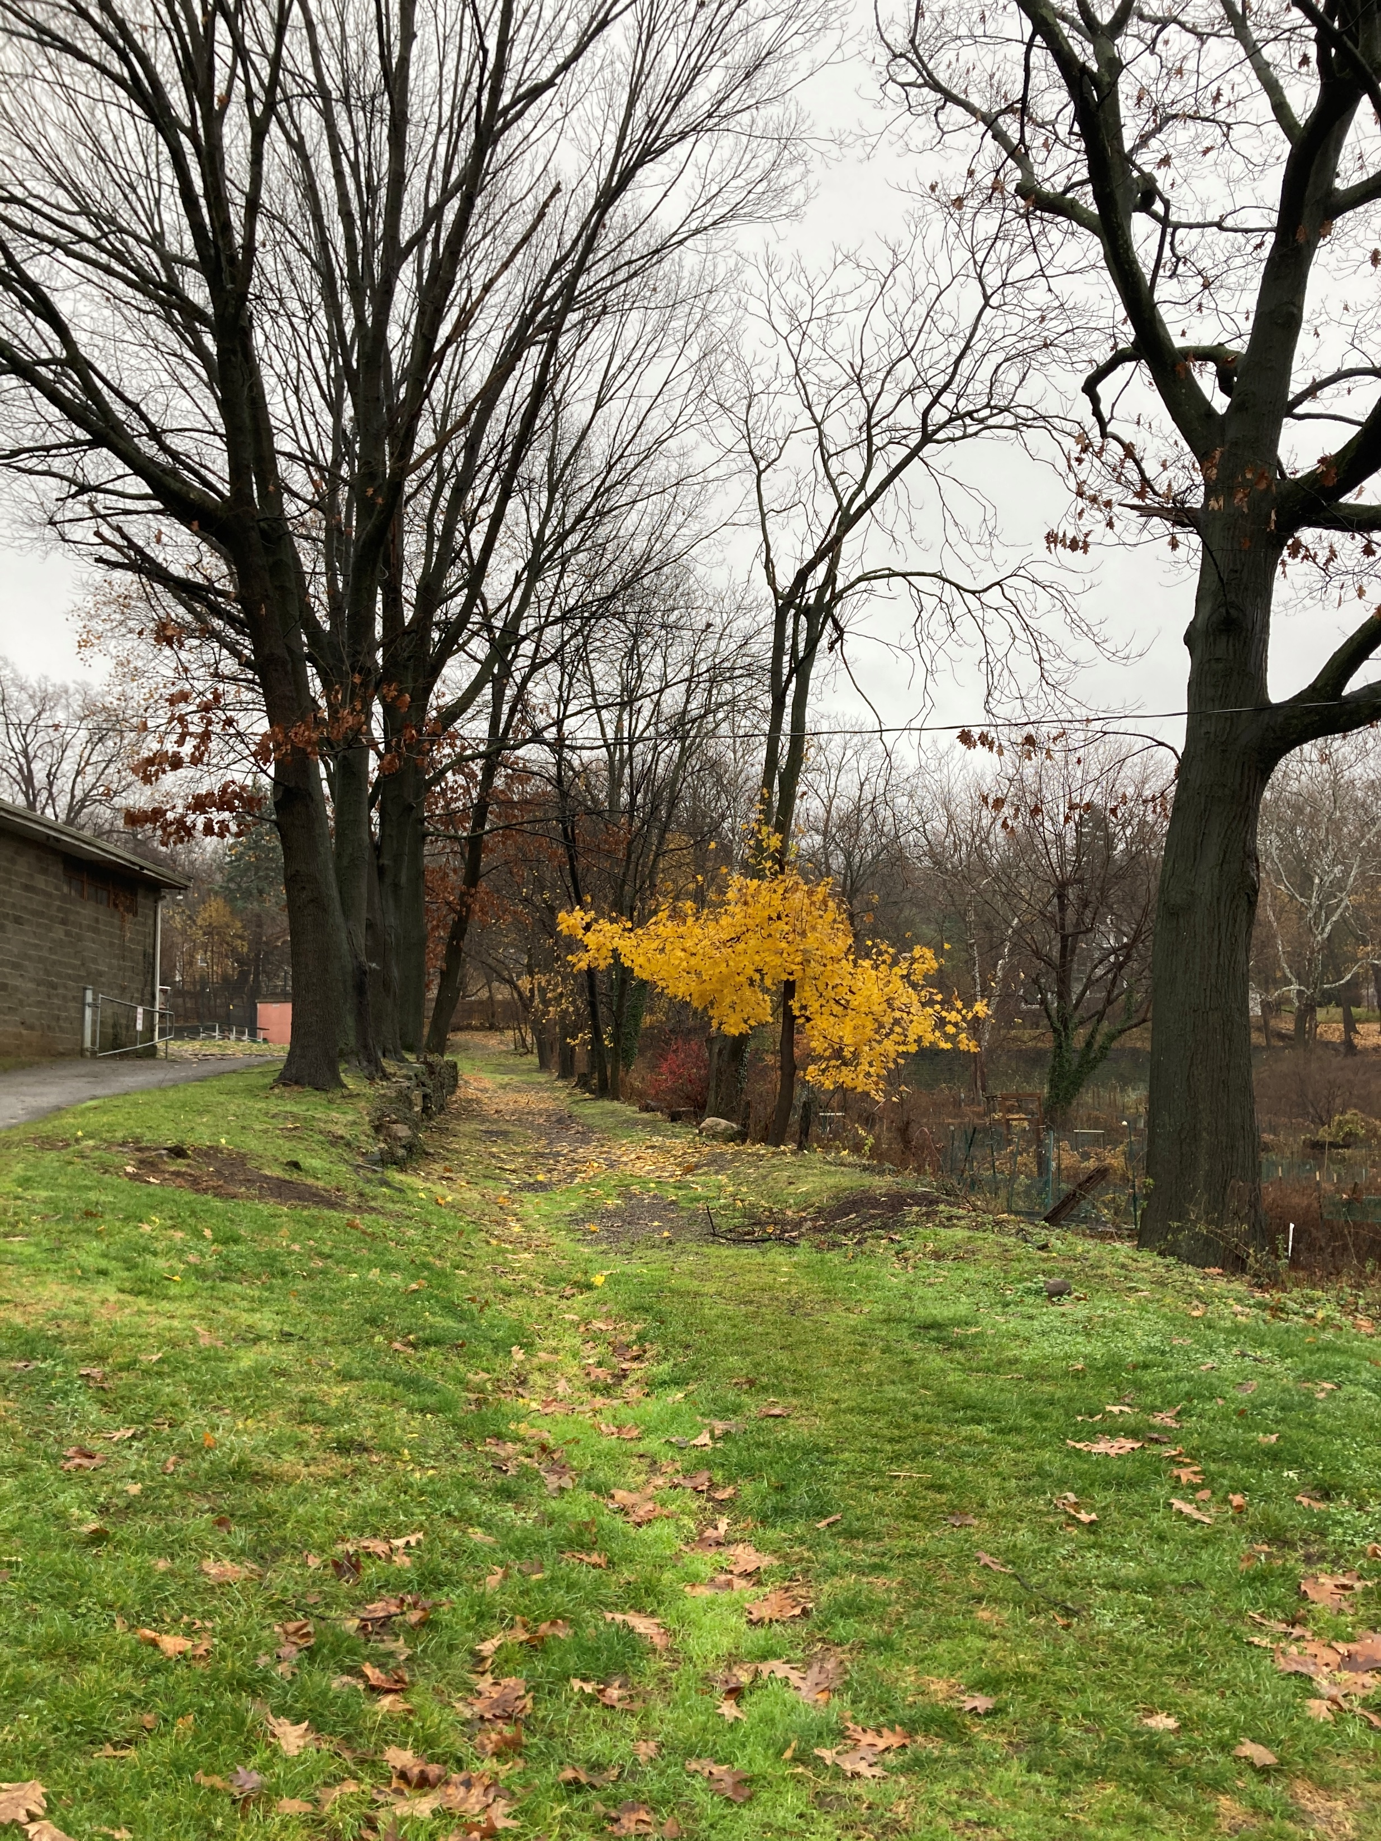
COMMITTEE TASKS & NEXT STEPS
Comprehensive Plan
Refinements to Version 3 Draft
Potential Committee Public Hearing scheduled
LWRP
Section IV – in progress

Slide 25
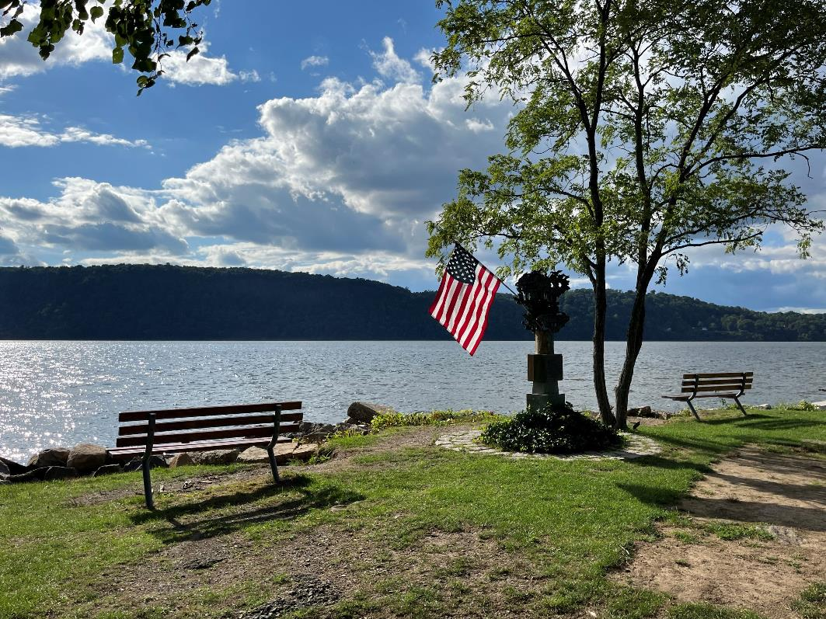
PUBLIC COMMENT

